Slide 1


Best Practices for Virtual Presenters

Slide 2
What you need to get started
An internet connected computer or laptop (wired is preferred not Wi-Fi)
Headphones or earbuds
A webcam

Slide 3
What to Wear for your Virtual Presentation
Wear something that is appropriate for your audience and makes you feel comfortable and professional. Choose a solid-colored dress shirt or blazer and avoid fabrics with small or distracting patterns.
Avoid wearing solid black or white as those can be hard for your camera to properly expose your face.
Be mindful of distracting jewelry, including anything that can bang on the tabletop.
Glasses often reflect the lighting, windows, and monitors. Consider your options.
If you are doing a pre-recorded session with Live Q&A at the end, consider wearing the same outfit, so it appears that the pre-recorded content was “live”.

Slide 4
Your Virtual Meeting Room

Slide 5
Background
Windows in the background are often a challenge for webcams. Avoid sitting with your back to a window or bright light as you will be in silhouette.
Be cognizant of the detail behind you in your camera shot. Your audience will notice everything, and it can distract their attention from your presentation.
Try to keep the background simple by avoiding anything that looks busy or cluttered. Simply choosing a plain wall as your backdrop is often best.
Isolate yourself from noises that could happen at home or outside during your presentation. Some examples: lawn work, home telephones, a smoke detector with low batteries.
Dog barks and other pets are the most common interruption that affect a presentation.

Slide 6
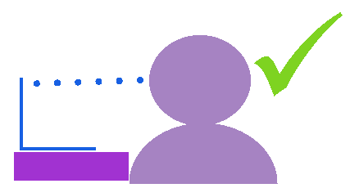
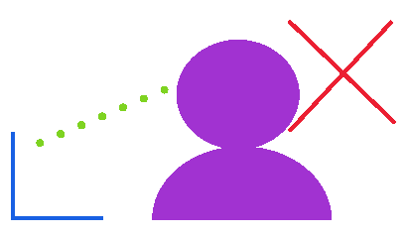
Webcam Placement
Some camera angles can exaggerate your facial features and distort your appearance. Fortunately, simply placing your webcam properly can go a long way to achieving the look you want. Whether you are using a USB webcam or the built-in webcam on your laptop, make sure that the camera lens sits at or above eye level, no higher than your hairline.

Slide 7

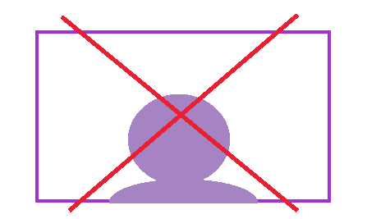
Webcam Placement
Once your webcam is in place, remember not to sit too close to the camera. Position your webcam far enough away to capture your shoulders and your entire face with some room to spare. Leave some “headroom” don’t cut off your forehead.
Don’t sit too low that you start to disappear off camera.

Slide 8

Lighting
Ideally, you want to light yourself from the front with soft, indirect light.
Place a light with a lampshade in front of you, behind your webcam.
Being near a window with indirect light behind your camera can look great! If the window has direct sunlight, considering diffusing the light with shear curtains or other covering that still allows light through.
Ring lights that attach to desks are the best option. The bigger the ring, the softer the light and better looking.

Slide 9
Recording Tips

Slide 10
Tips and Suggestions for Recording
If you have a swivel chair, be sure to not move side to side. This can be distracting for viewers and if editing is required, can make it difficult as you move in frame.
Don’t use ‘clicker’ pens. People tend to fidget with them and click them without realizing they are doing it.
Sit in a place free from distraction, whether that be from other people in your office/house or pets.
Turn off your cell phone or put it on silent (no vibrate). If it rings or vibrates during your recording, that will be picked up in the sound.
Turn off all other computer programs other than Zoom.
Don’t rustle or shuffle papers as the sound usually gets picked up and can also be visually be distracting.

Slide 11
How to Engage Your Audience

Slide 12
Connect with your audience
Pick a point near the camera to talk to – if it helps put a piece of tape as a visual reference.
Stack books or a box under your laptop to raise your webcam to eye-level.
If you are using notes, outlines or timers, position them around camera so you keep eye contact vs looking distracted.
Look directly at the camera. While it’s perfectly fine to peek down at your presentation materials and other participants from time to time, that also makes you look distracted.

Slide 13
Technology Tips

Slide 14
Internet Connection
Tell others to not use the internet, stream movies, or play video games during your presentation/RECORDING.
Turn off all devices except your computer. Turn the WIFI off on all phones, tablets, and other computers.
Airplane mode is another quick way to shut off mobile devices WIFI connection.
A wired connection to your router or modem is the best option to get maximum internet speed.
MAKE SURE ALL COMPUTER UPDATES ARE COMPLETE OR TURNED OFF.
AUTO UPDATES SOMETIMES RUN AUTOMATICALLY IN THE BACKGROUND AND SLOW DOWN YOUR INTERNET CONNECTION.

Slide 15
Computer
Restart your computer an hour or two before it is time to present. Make sure you don’t have any automatic updates that may start during your presentation or recording.
Close all programs except those needed to present.
Plug in your headphones/earbuds into your computer or make sure your Bluetooth headphones are connected and working.
In Zoom settings, be sure to turn on maximum noise suppression in the sound settings. (See next slide for how to do this)
If you will be using a laptop, plug it in and leave it plugged in. This stops the laptop from disabling certain power/battery functions and it’s a backup in the event you forget to charge it!
Turn off or mute anything that might make sounds during your presentation, for example; notifications when emails come in or cell phone notifications.

Slide 16
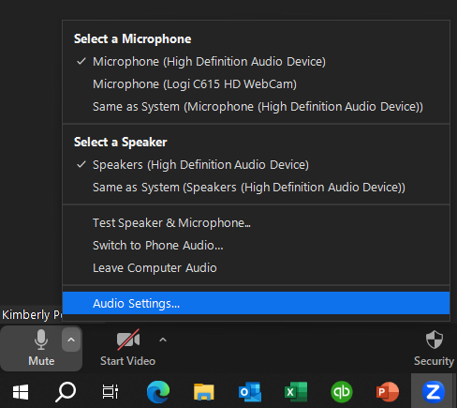
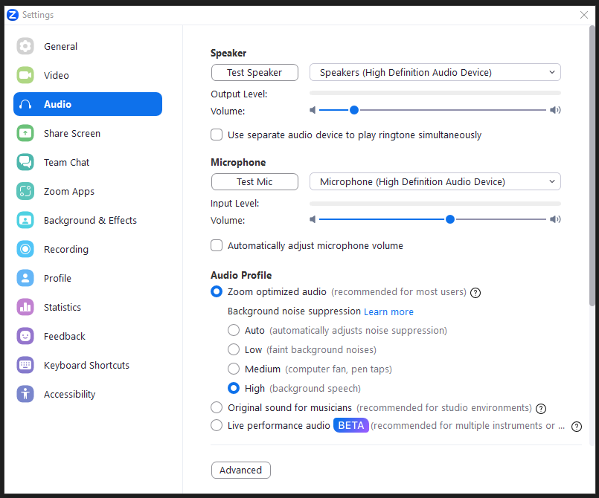
Noise Suppression Settings
When in Zoom, select the arrow up next to the microphone icon and select Audio Settings.
Under Audio Profile, select “High” under Background noise suppression.

Slide 17
Content Tips

Slide 18
Tell the story
Know what the key take-away is for your presentation.
Does your take way match what your audience heard?
Use simple words that capture people’s attention.
Your cadence and intonation add to the story – use them to your advantage!

Slide 19
Keep it simple
It's better to have more slides with fewer bullet points rather than have fewer slides with dense bullets.
If you need to use bullet points, then remember:
Be concise
Use graphics and icons
Limit to 3 bullet points
Remember the mobile audience. Don’t make your text too small, too light or too dense.

Slide 20
Things to Avoid
Avoid alluding to dates or events (“just yesterday,” ”tomorrow,” “a week ago,” etc.)
Don’t discuss specific dates or days. As this will be a recording, it could air weeks after the date you mention so it is no longer recent history.

Slide 21
Rehearse
Record and review.
Practice without slides so story resonates.
Present to a person and ask them what 1 thing they learned – does it match your key message?
Does your audio track to the visuals on your slides?
Use facial expressions and hand gestures as appropriate.
Have water available, practice taking a drink, while on camera.
Make sure audio is clear and limit background noise.
Is your background appropriate for your audience and your message?
Confirm lighting works so people can see your face and expressions.

Slide 22
Director Instruction

Slide 23
Director Instructions and Tips
Before starting recording, you may be directed to change your lighting, adjust your camera angle, or change sound settings/microphones. Extra time will be allotted when the recording is scheduled for these adjustments.
If there are technical issues prior to beginning the recording, we may ask to reschedule the recording in order to fix those issues.
During your recording, you may be asked to stop and start over, either due to background noise or some other technical reason. This is not personal.

Slide 24
Director Instructions and Tips
Don’t be afraid to stop and start over. If you are happy with the presentation so far, simply restart from the beginning of your slide or discussion point. BEFORE restarting, pause for a couple of seconds (SILENTLY count to 5 in your head), and start over. This allows us a good cut point during editing.
Practice sharing your screen (if you have a presentation) and advancing slides while presenting.
If you use multiple screens, we suggest making sure your presentation or notes are on the screen that allows you to look at the camera. Don’t glance off to the side.

