Slide 1
DRBF R3 Breakfast Briefings December 2021
DRBFR3: 2021: Year in Review
Presenter: Ron Finlay, Secretary, DRBFR3

Slide 2
Summation
2021 was affected by COVID-19 lockdowns in most states
DRBFR3 activities continued in electronic format
DBs continued, also mostly in electronic form
DRBFR3 emphasis on educating Clients, Users and Advisers
DRBFR3 to become more active to support the DB model

Slide 3
DRBF Membership 2021
Region 1 (North America): 259
Region 2 (Rest of the World): 491
Region 3 (Australia and NZ): 83 (with 80 being available for DB roles, and of whom 72 have participated in at least one Advanced Training Workshop)
Total: 833

Slide 4
Dispute Boards in Region 3
New in 2021
Bruce Highway, Cooroy to Curra Section D / Contract 1
Bruce Highway, Cooroy to Curra Section D / Contract 2
Gateway Project, Sydney Airport
M6 Motorway Stage 1, Sydney
Sydney Road Assets Performance (SRAP) Contract (Harbour Zone)
Sydney Road Assets Performance (SRAP) Contract (Parkland Zone and Regional ITS)
Sydney Road Assets Performance (SRAP) Contract (River Zone)

Slide 5
Dispute Boards in Region 3 (Cont’d)
Continuing in 2021:
Carmichael Rail Line Project, Qld
Colossus: Provisioning and Networks Field Services
Ipswich Motorway Rocklea to Darra Stage 1, Qld
Megalodon 5G Rollout #1
Megalodon 5G Rollout #2
Megalodon 5G Rollout #4
Moorebank Intermodal Project
Nowra Bridge - Second Crossing

Slide 6
Dispute Boards in Region 3 (Cont’d)
Continuing in 2021:
Parramatta Light Rail (PPP)
Parramatta Light Rail: Infrastructure
Princes Highway - Batemans Bay Bridge
Rozelle Interchange (M4 and M5 Connection)
Snowy Hydro 2.0 Project
Total value of current projects: > $16 billion
Number of DB members serving: 35

Slide 7
Status of the DRBF R3 Mentoring Program
Two, possibly three, Mentor arrangements underway
Expressions of interest sought from Mentors and Mentees
Process for matching Mentor and Mentee
Process steps:
Obtaining the consent of fellow DAB members
Form of Deed Poll (conflict declaration and confidentiality)
Obtaining the consent of the DAB parties

Slide 8
Status of the DRBF R3 Mentoring Program (cont’d)
Successful engagement and establishment of Mentor/Mentee relationships on:
Parramatta Light Rail
Rozelle Interchange
Likely soon:
Sydney Gateway Project
Other matches continuing to be sought

Slide 9
Developments in Victoria
DRBF first approached Office of Projects Victoria (OPV) in July 2019
Persistence led to provisional acceptance and a Survey being undertaken by OPV through Infrastructure Australia Group
Resulted in a recommendation to Victorian Treasury in December 2020 of an “If not, Why not” approach for use of a DB on all High Value/High Risk (HVHR) projects

Slide 10
Developments in Victoria (cont’d)
Recommendation included:
Record of DBs in Australia is positive and should be trialed in Victoria
Three stages of decision making for evaluation of the use of Dispute Boards
Gate 2: Business Case
Gate 3: Market Readiness
Gate 4: Tender Decision

Slide 11
Developments in Victoria (cont’d)
Decision making framework being established
Highly likely first trial DB in Q1 2022

Slide 12
Developments in New South Wales
NSW 10-Point Action Plan
NSW Construction Framework
TfNSW as major client/user (13 of current 20 Dispute Boards)
Loss of a “champion” in Head Office
TfNSW Training Session for senior executives – scheduled for March 2022

Slide 13
Developments in New South Wales (cont’d)
Construction Industry Leadership Forum
Standard form contract

Slide 14
Developments in Queensland
TMR remains a major user of DBs and an enigma
Devolution of procurement responsibility largely to 12 Regions
Loss of a “champion” in Head Office
Appointment of a General Manager may be important
Potential adoption of “Collaborative Contracting” model also presents opportunities

Slide 15
2021 Virtual Advanced Training Workshop
18 registrants participated in the Workshop which was conducted on the DRBF Zoom platform over two half days – Tuesday 28 and Wednesday 29 September 2020 for four hours
The presenters were Day 1: Ron Finlay and Steve Goldstein; Day 2: Ron Finlay and Barry Tozer
A new session on the First DAB Meeting was included this year

Slide 16
2021 Virtual ATW (cont’d)
The slide pack was presented on all registrants’ screens and the Zoom meeting format also allowed for all registrants’ videos to stay on. In addition to questions coming through the Chat Room, follow-up questions happened live
At the conclusion of the Workshop an electronic survey was provided to all registrants. 16/17 responded providing comments about the presentations, session papers and other collaterals, or what they would like to see as subjects in a future ATW. General ratings were 8/9 out of 10

Slide 17
2021 Virtual ATW (cont’d)
The Virtual Workshop overall was very successful. Given the state of the world in 2022, the R3 Board will review the decision whether to hold the Workshop again virtually or in-person

Slide 18
2021 R3 Breakfast Briefings
Breakfast Briefings generally well received
Average attendance of 30+ members
February – Without Prejudice - Ron Finlay
March – ACA Update - Jon Davies
April – Decision Writing - Graham Easton
May – Ethical issues in DB practice - Steve Goldstein
June – FIDIC - Kiri Parr
July – What does DB Success look like? - Alan McLennan
August – Handling Expert Reports in the DB World - Ian McIntyre

Slide 19
2021 R3 Breakfast Briefings (Cont’d)
September – DB User Experience Marmaray Project - George Sanos
October – Managing Construction Risks Collaboratively - Barry Tozer
November – Dispute Avoidance Practice and Procedures - Stephen Callaghan
December – DRBFR3: 2021: Year in Review
Suggested Topics and speakers for 2022 – awaiting volunteers
First session: 1 or 8 February 2022

Slide 20
DRBF Website - CVs
All DRBF members have access to the international website: www.drb.org
Please ensure your Profile/CVs are up to date as we refer potential Users to that website
DRBF tutorial video available on the Region 3 Hub of the website

Slide 21
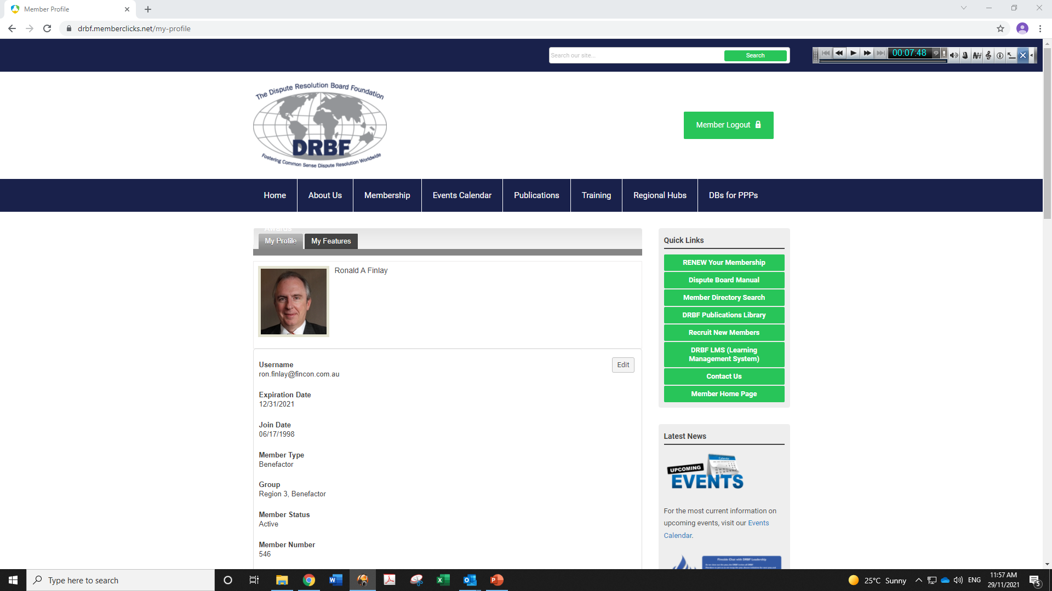
DRBF Website – CVs (cont’d)

Slide 22
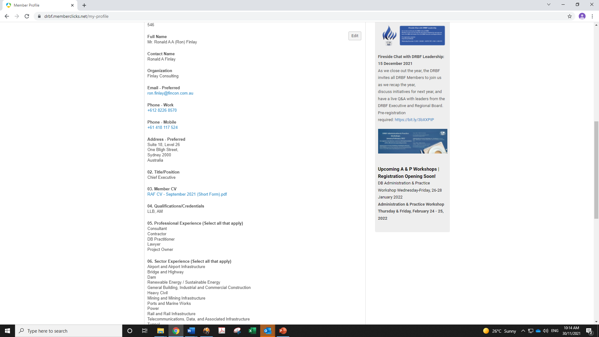
DRBF Website – CVs (cont’d)

Slide 23
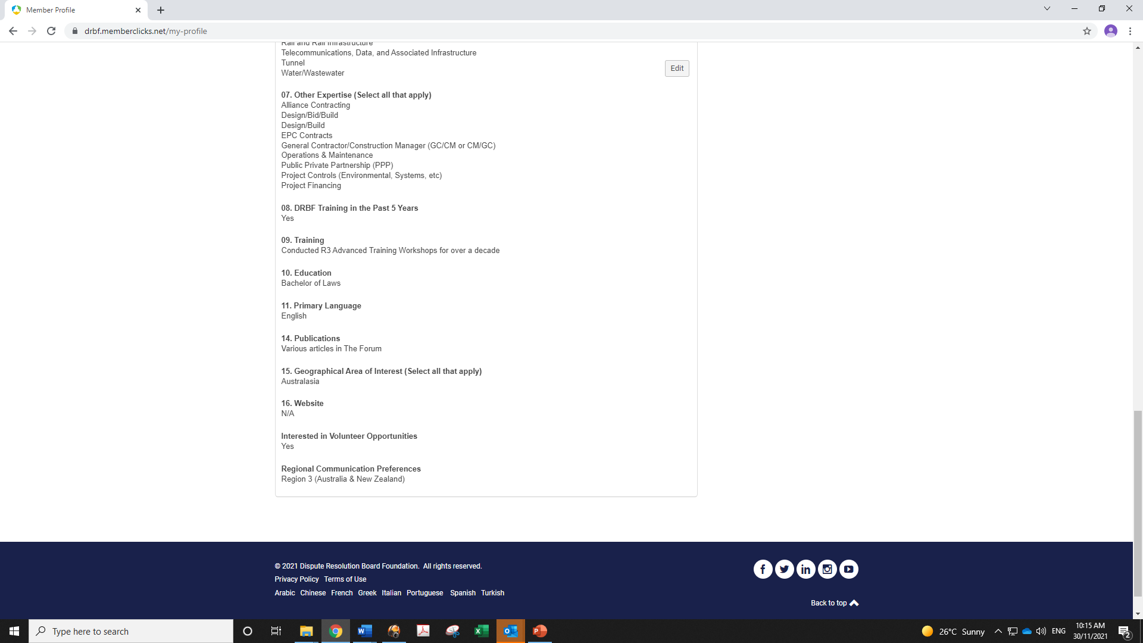
DRBF Website – CVs (cont’d)

Slide 24
DRBF R3 Submissions
NSW Treasury PPP Guidelines
TMR and IAQ Collaborative Contract Charter
Newcastle Inner City By-Pass Project (separation of avoidance and decision-making)
Sydney Metro IDAR Panel for Western Metro and Western Sydney Airport Metro

Slide 25
Educating Owners/Users/Advisers
New DBs will only come from persistence
DB track record in Australia outstanding
107 projects ($59.96 million) and no dispute resulting in litigation, judgment or arbitral award – all within Project/Contract/DAB/DB
Every R3 member is an advocate
Please find opportunities
Public or private sector
R3 will provide support and resources

Slide 26
Educating Owners/Users/Advisers (cont)
Example: New Bridgewater Bridge, Hobart
Infrastructure Australia Guidelines
Construction Industry Leadership Forum (NSW, Victoria, possibly Queensland)
Office of Projects Victoria – Trial of DAB

Slide 27
Forward Planning (2022)
Continuing Outreach activities
DRBF R3 Conference (July/August 2022 in Brisbane)
Future opportunity - Brisbane Olympics 2032

Slide 28
MEMBER FEEDBACK QUESTIONS / COMMENTS

Slide 29
DRBF
Website: www.drb.org
Email: info@drb.org
DRBF Region 3
Website: www.drbf.org.au
Email: admin@drbf.org.au

